Slide 1
Lesson 3 - Divs
Mr Mack 2019

Slide 2
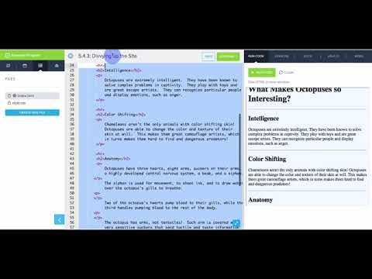
Divs

Slide 3
What is the function of the div tag?
To define a section of an HTML page
To group a block of elements together to format them with CSS
To efficiently apply the same style to several different elements
All of the above

Slide 4
Which of the following correctly uses div to style multiple elements the same way?
<div class="intro">
<h2>Welcome</h2>
<p>Hi, welcome to my page.</p>
</div>
<div>
<h2 class="intro">Welcome</h2>
<p class="intro">Hi, welcome to my page.</p>
</div>
<div>
.intro{
font-size: 16px;
font-style: italic;
}
<h2>Welcome</h2>
<p>Hi, welcome to my page.</p>
</div>
<h2 div class="intro">Welcome</h2>
<p div class="intro">Hi, welcome to my page.</p>

Slide 5
Example: Divvying up the Site
This webpage demonstrates how div can be used to divide a webpage into its logical components: featured content, main content, and footer information. Then, specific styles can be applied to each piece.

Slide 6
Exercise 4.3.1: Quotes
This is an article taken from CodeHS’ Medium blog.
There are a few quotes throughout the article that need to be highlighted.
Put any text that is floating outside of a paragraph tag inside a <div> tag.
Give these tags the class quote.
Then create a CSS rule inside of style.css for quote to make the font Arial, 20px big, and italicized.

Slide 7
Exercise 4.3.2: Flags
Let’s play around with <div>’s. You will create the flag of the Netherlands by creating rectangles of color using <div>’s.
The Steps
Give the page the title Netherlands Flag
Create 4 <div> tags in the body
Give the first <div> the class header.
Put the text “Flag of the Netherlands” in the first <div>
Give the second <div> the class red and rectangle
Give the third <div> the class white and rectangle
Give the fourth <div> the class blue and rectangle
Create a CSS file called style.css
Add rules for the classes red, white, and blue. Make their background colors correspond to their names (i.e. make the red class have a red background)
Make the width of class rectangle 800px
Make the height of class rectangle 150px
Make the background color of class header LightSkyBlue.
Run your code to see the Netherlands Flag!

Slide 8
Exercise 4.3.3: Career Site: Separate the Content
Copy your HTML code from the previous Career Profile website exercise
In this exercise, we’re going to add some distinction between the pieces of our webpages.
Add the Divs
First, add three <div></div> tags to each of your html pages.
The first <div> should go around the <h1> title of the page. Give it the class header.
The second <div> should go around the rest of the content on the page, except for the last link to the other html page. Give it the class content.
Finally, the third <div> should go around the last link to the other html page. Give it the class footer.
Add the Styles
Now let’s style each of these <div> tags in style.css.
Class header should have:
a solid border (use border-style)
the same background color as the body’s (we’re going to change the body’s in a bit)
Class content should have:
the same background color as the body’s
height of 80%
width of 70%
Class footer should have:
the same background color as the body’s
Change the background
Finally, remove the background-color of the body. Find a picture related to your job. Set it as the background-image of the body, like this:
background-image:url("link_to_my_picture");

